Slide 1

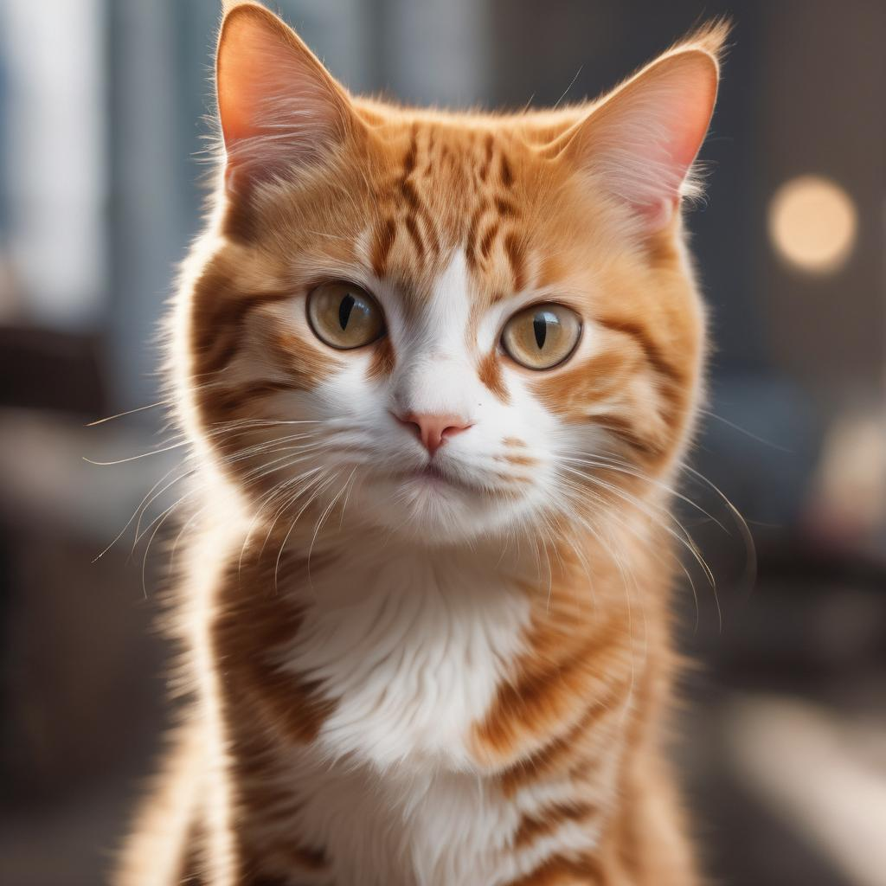
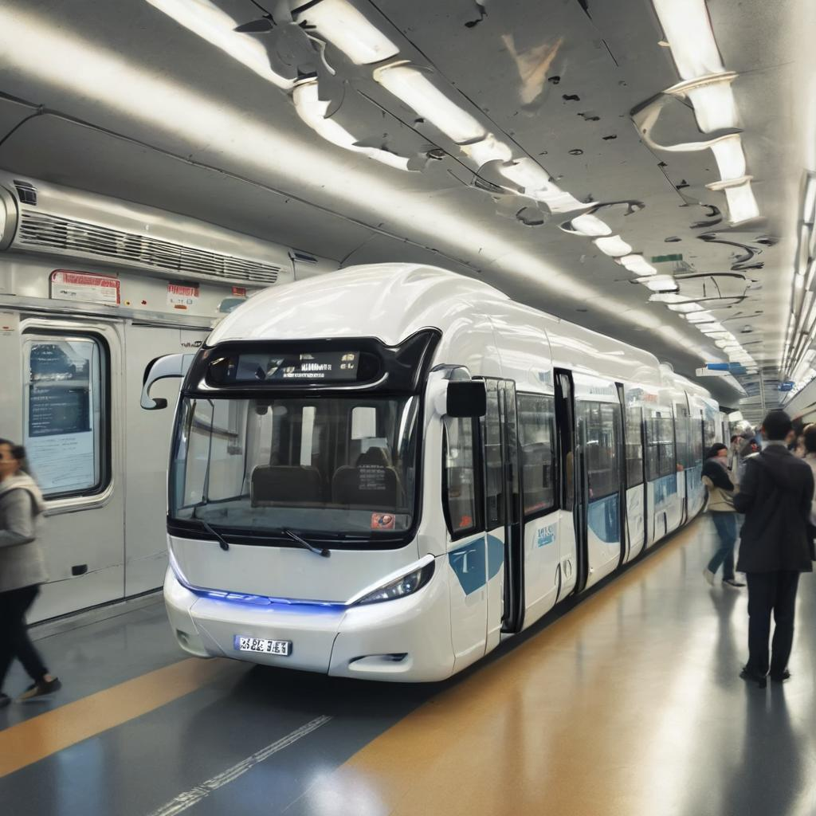
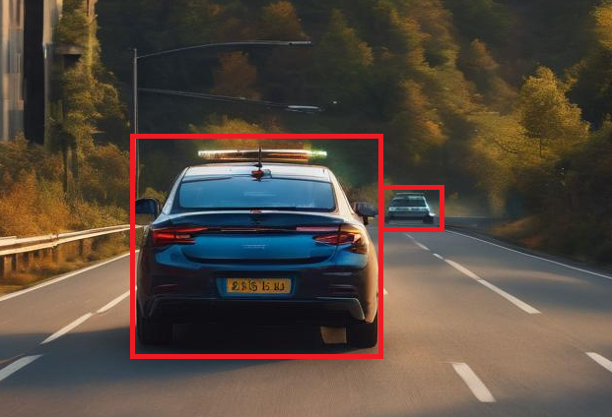
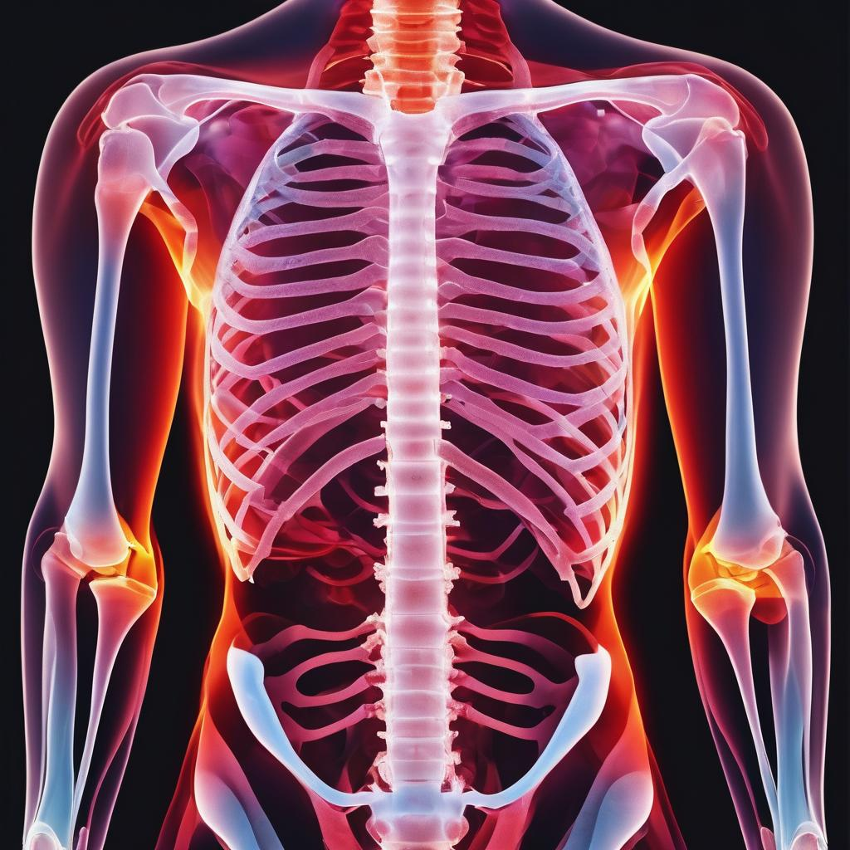
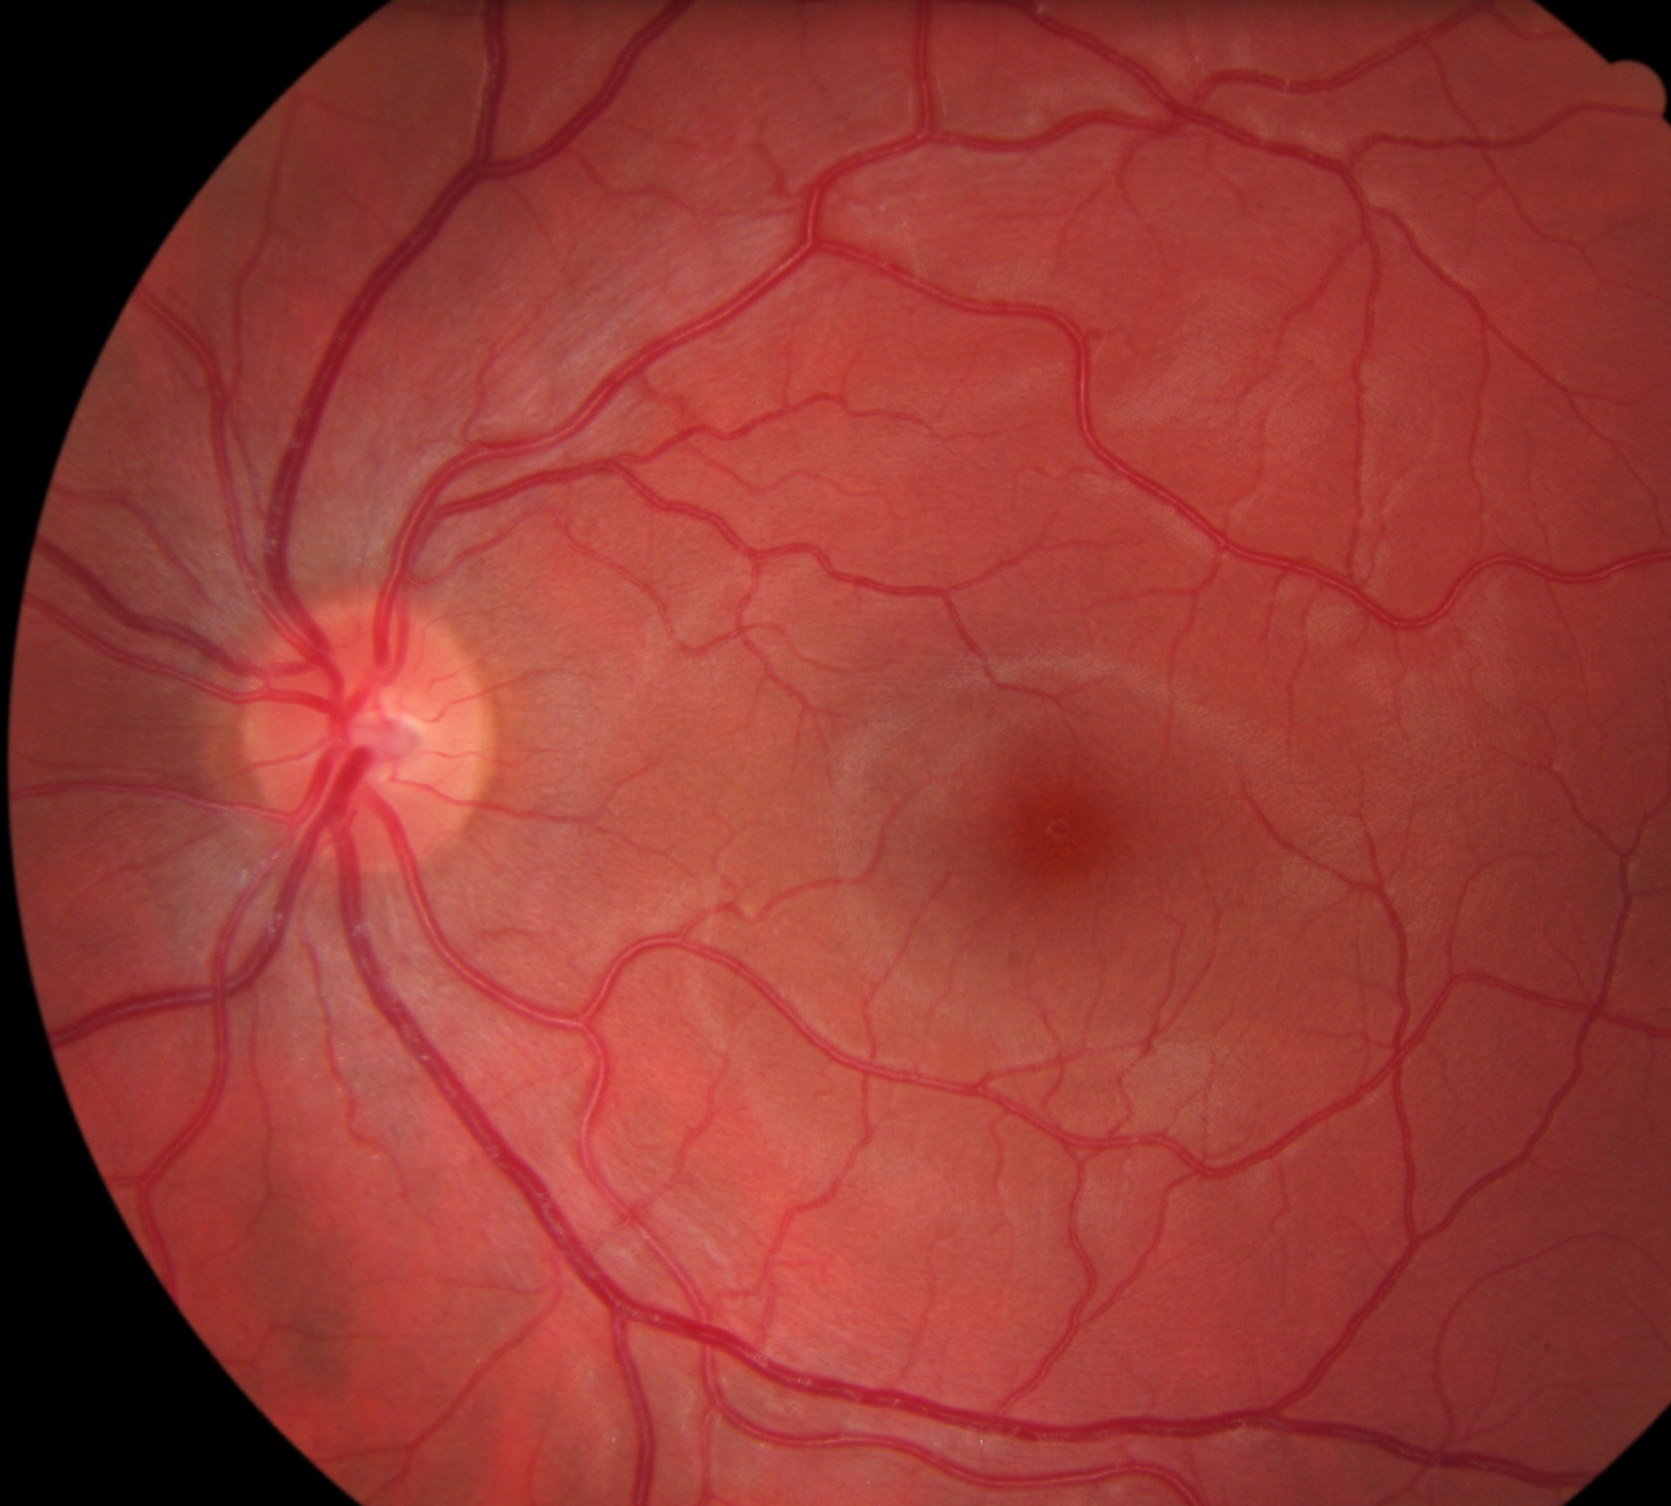
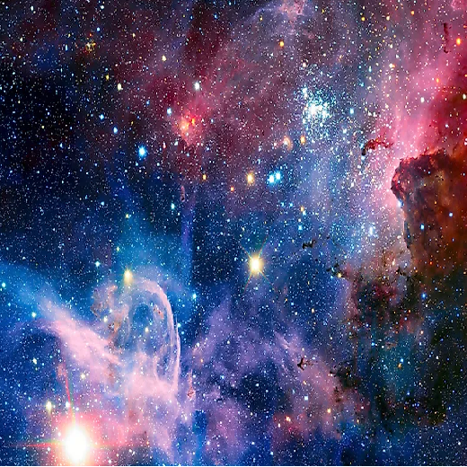
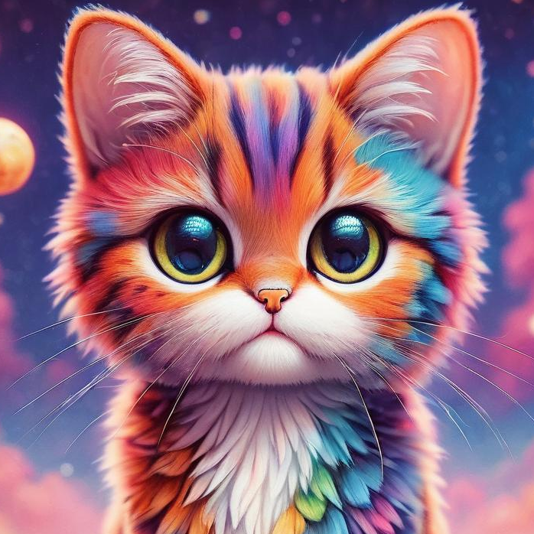
CNN: Common Use Cases
Image Classification
Object Detection
Neural Style Transfer
Cat?
5. Autonomous Transport
6. Healthcare
+ →
Celestial style cat

Slide 2
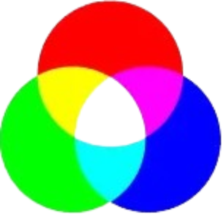
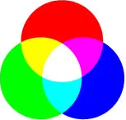
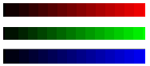
CNN: Additive Color Mixing
Images made up of pixels
Every pixel has 1 byte for Red, Green & Blue each
Each byte can have values 0 to 255 (Hex: 00 to ff)
For intensities of Red, Green & Blue (r, g, b) respectively
Intensity of R, G & B

